Slide 1
How Can A Wellness Technology Company Play It Smart?
Bellabeat
October 2021

Slide 2
Objective:
What are some trends in smart device usage?
Findings:
Wears their device throughout the day, regardless of physical activity.
Has an opportunity to exercise after 5PM on most weekdays except Friday and Saturday.
Does not travel far by foot, suggesting usage of an exercise facility.

Slide 3
Goals for analysis:
Identify behavioral patterns of smart device users.
Apply behavioral patterns to Bellabeat.

Slide 4
Goals for analysis:
Identify behavioral patterns of smart device users.
Apply behavioral patterns to Bellabeat.

Slide 5
How many users are exercising?

Slide 6
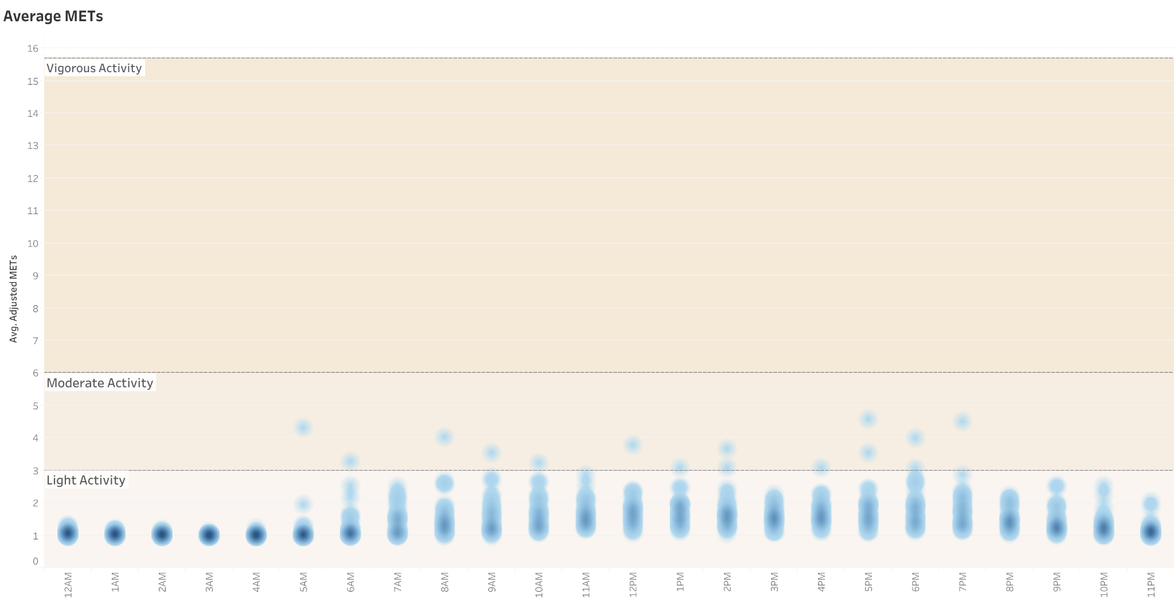
Low MET average suggests users spend more time sedentary than active.

Slide 7
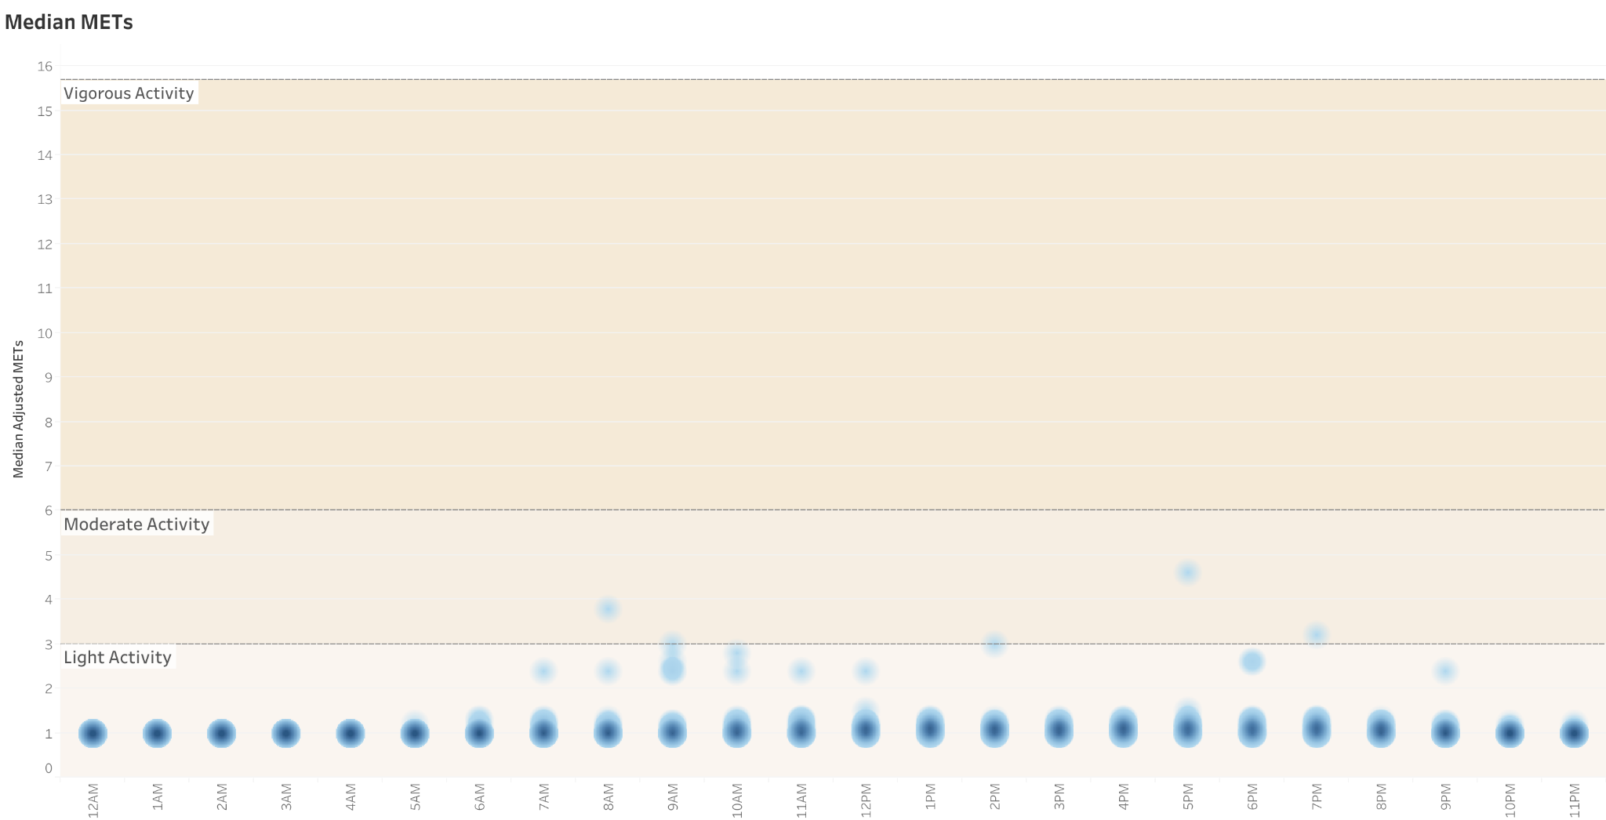
Low median values confirm the high count of sedentary (low) METs.

Slide 8
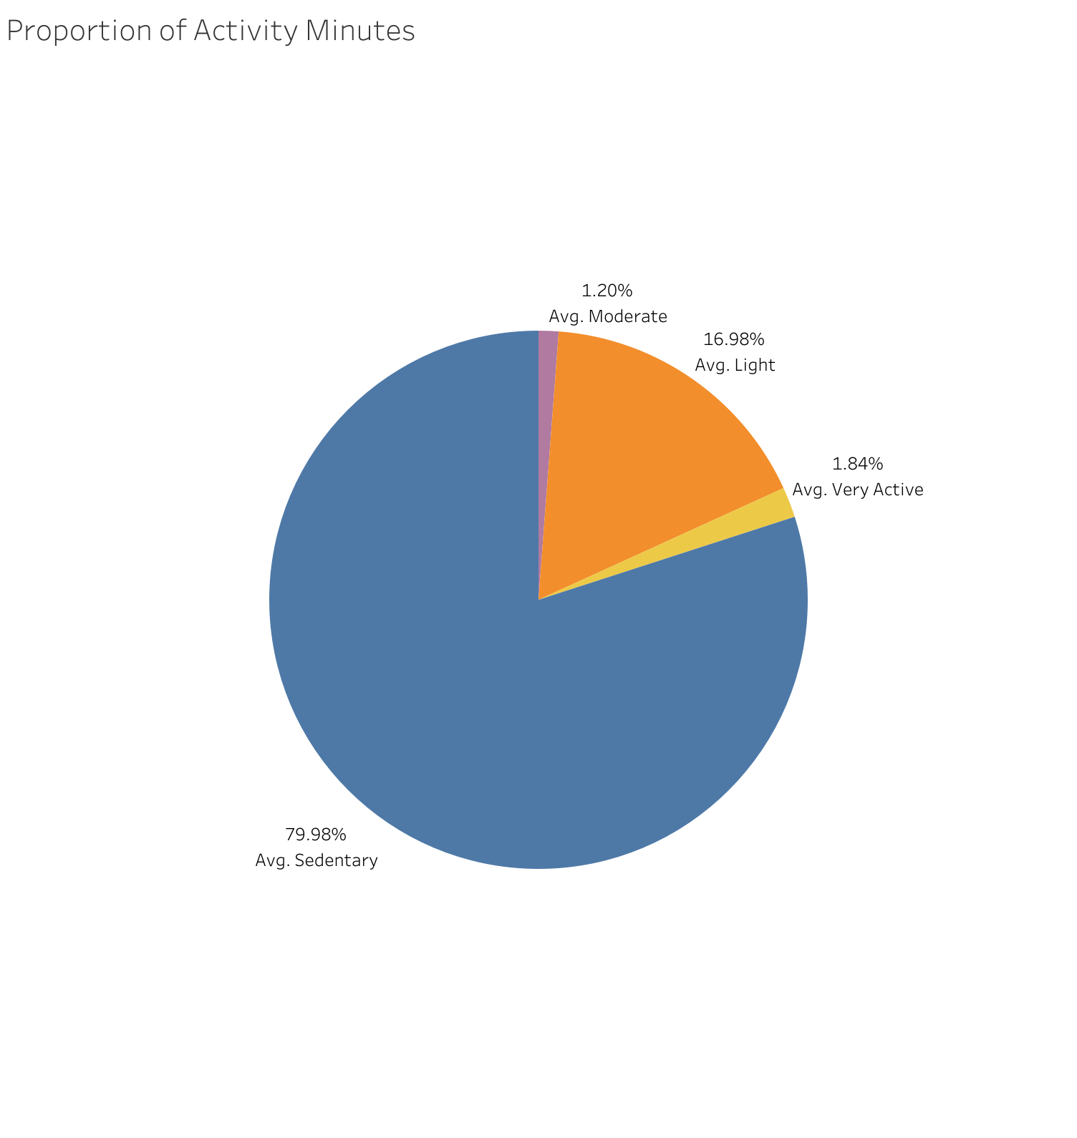
Most users spend their day in a sedentary state.

Slide 9
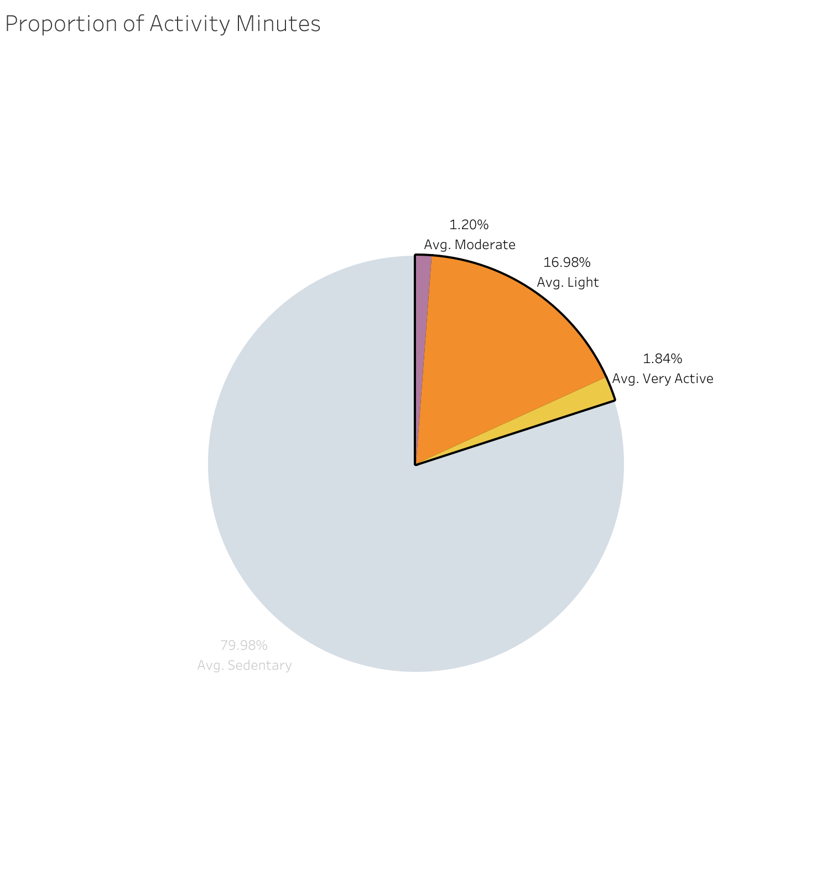
Users are more likely to partake in light activity than moderate or strenuous activity.

Slide 10
Insights
How many users are exercising?
Users spend most of their time sedentary.
Physical activity is most likely to be light.
<5% of time is spent in moderate/vigorous activity.

Slide 11
When are users exercising?

Slide 12
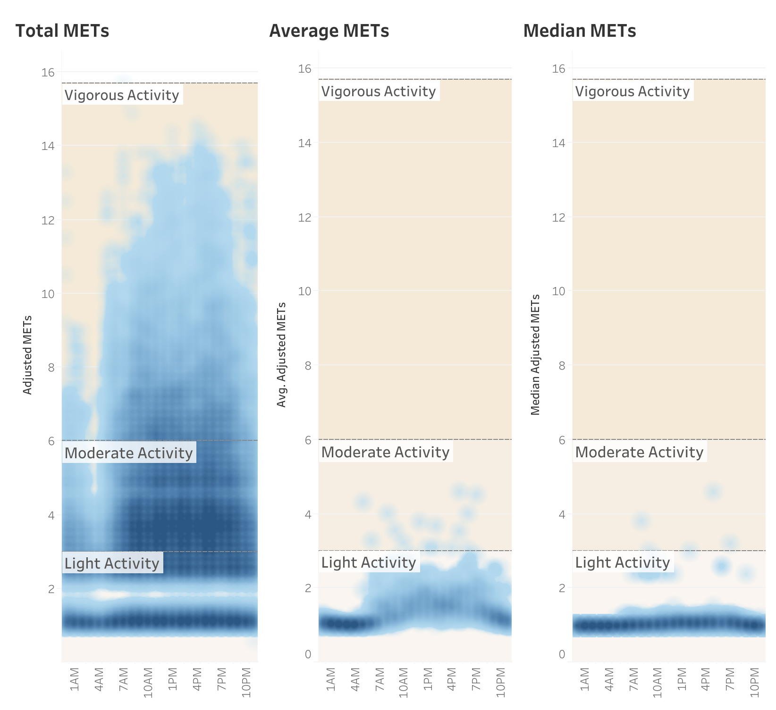
Bulk of physical activity stems from 7AM - 7PM range.

Slide 13
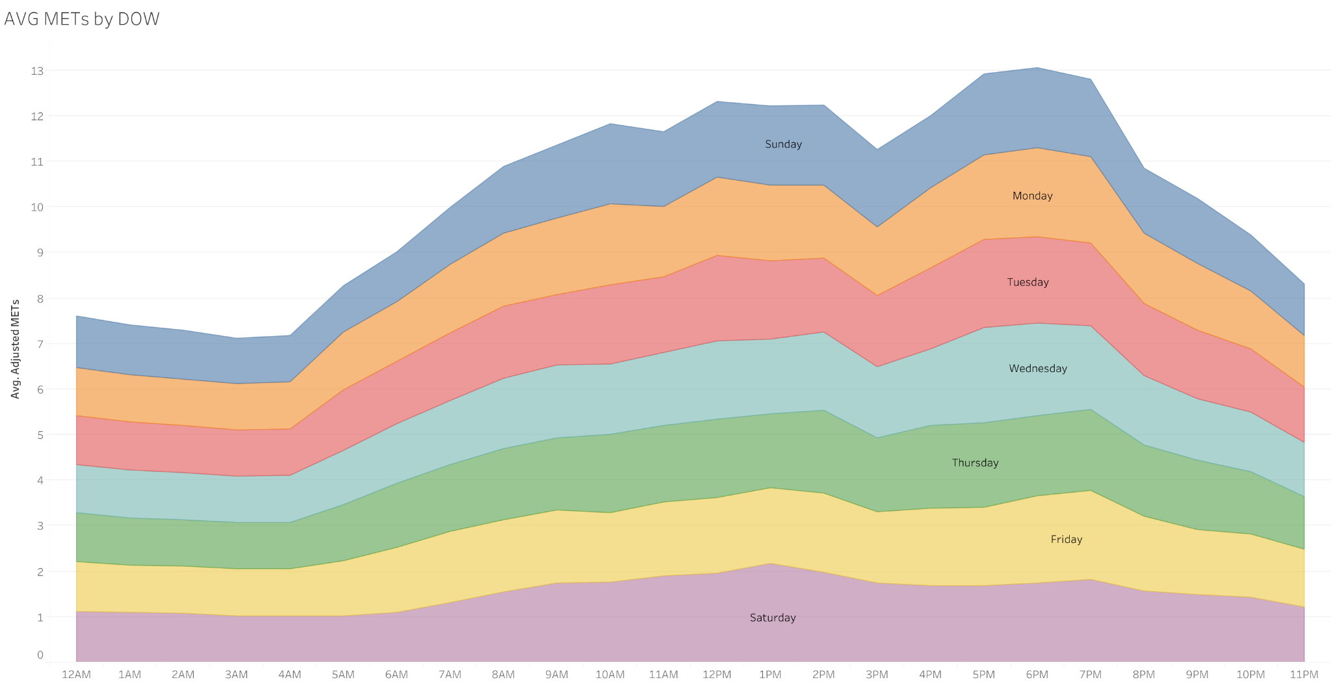
Consistent MET
drop from 2PM - 3PM
peak from 5PM - 7PM

Slide 14
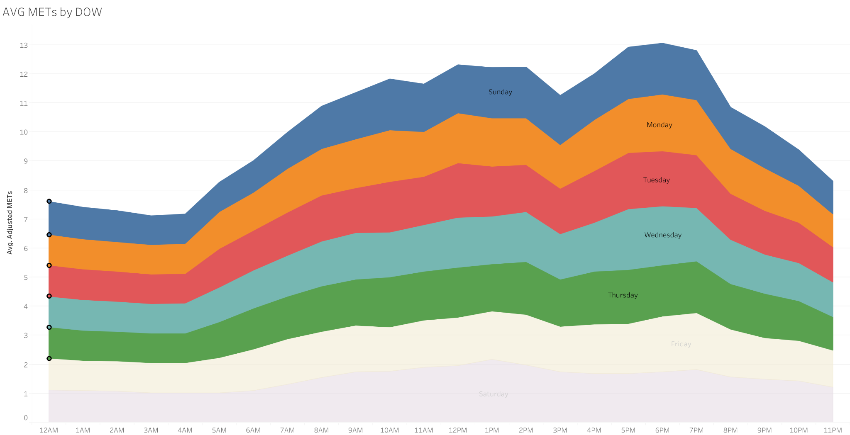
Sunday to Thursday see highest peaks.

Slide 15
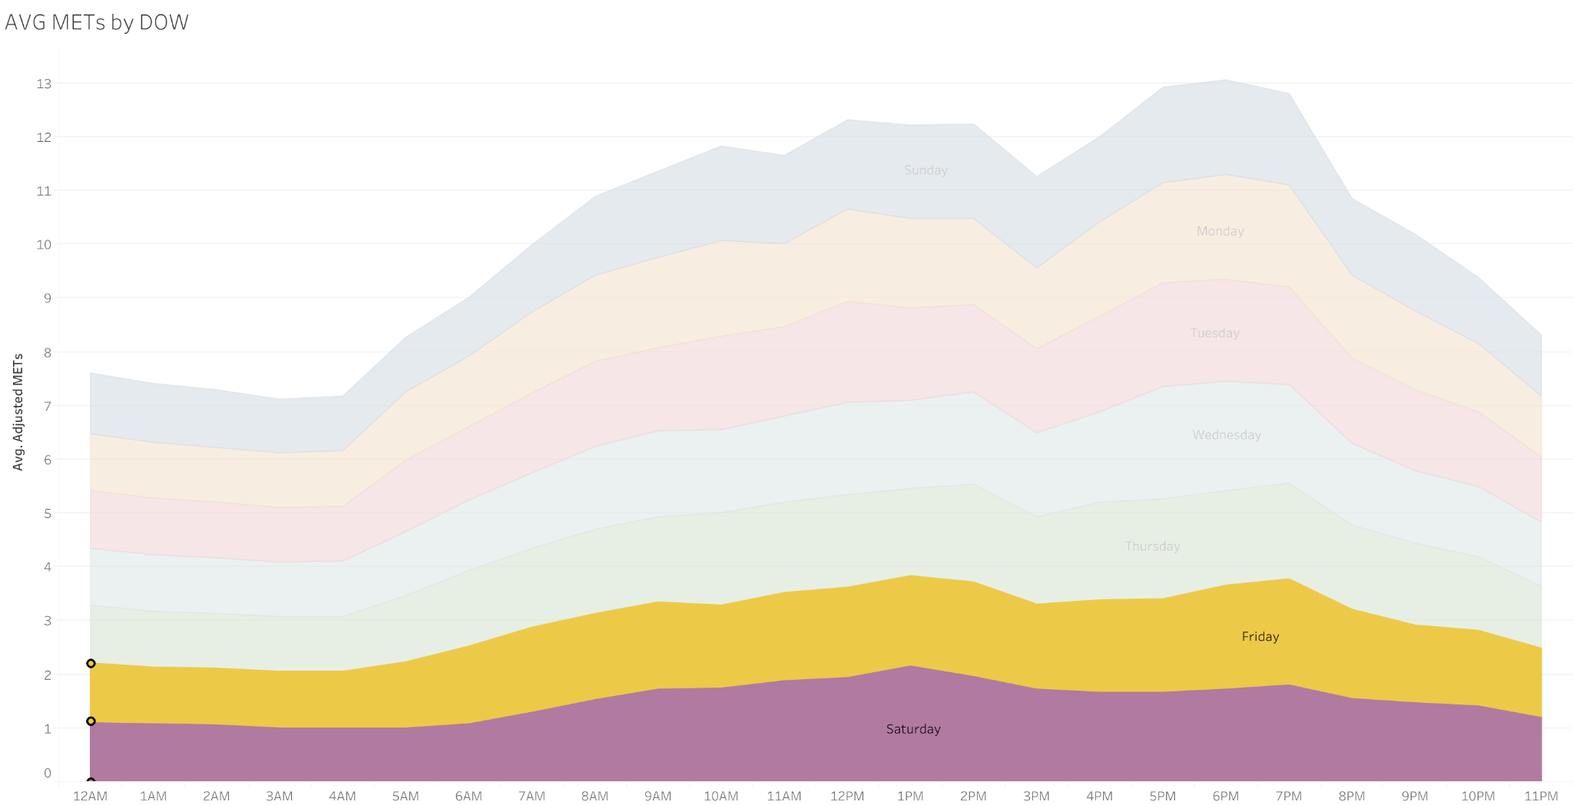
Peak smoothes out on
Friday and Saturday.

Slide 16
Suggests users are most likely to stick to exercise routine(s) on
Sunday to Thursday.

Slide 17
Insights
When are users exercising?
Most physical activity occurs between 7AM and 7PM.
Sunday through Thursday trend:
Activity drops off between 2PM and 3PM.
Activity peaks after 5PM.
Friday and Saturday have less overall activity.

Slide 18
How are users exercising?

Slide 19
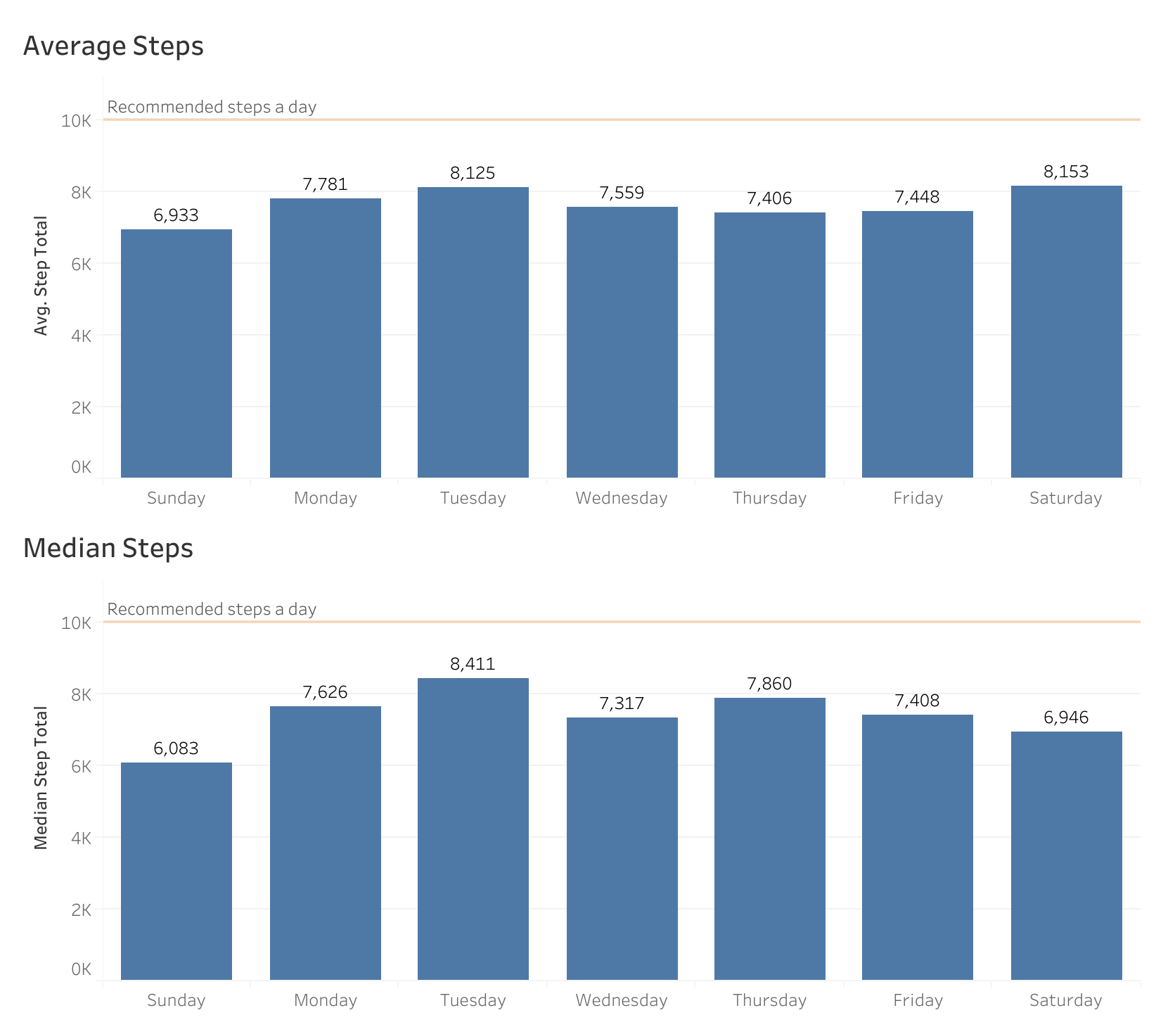
Users are not taking many daily steps.

Slide 20
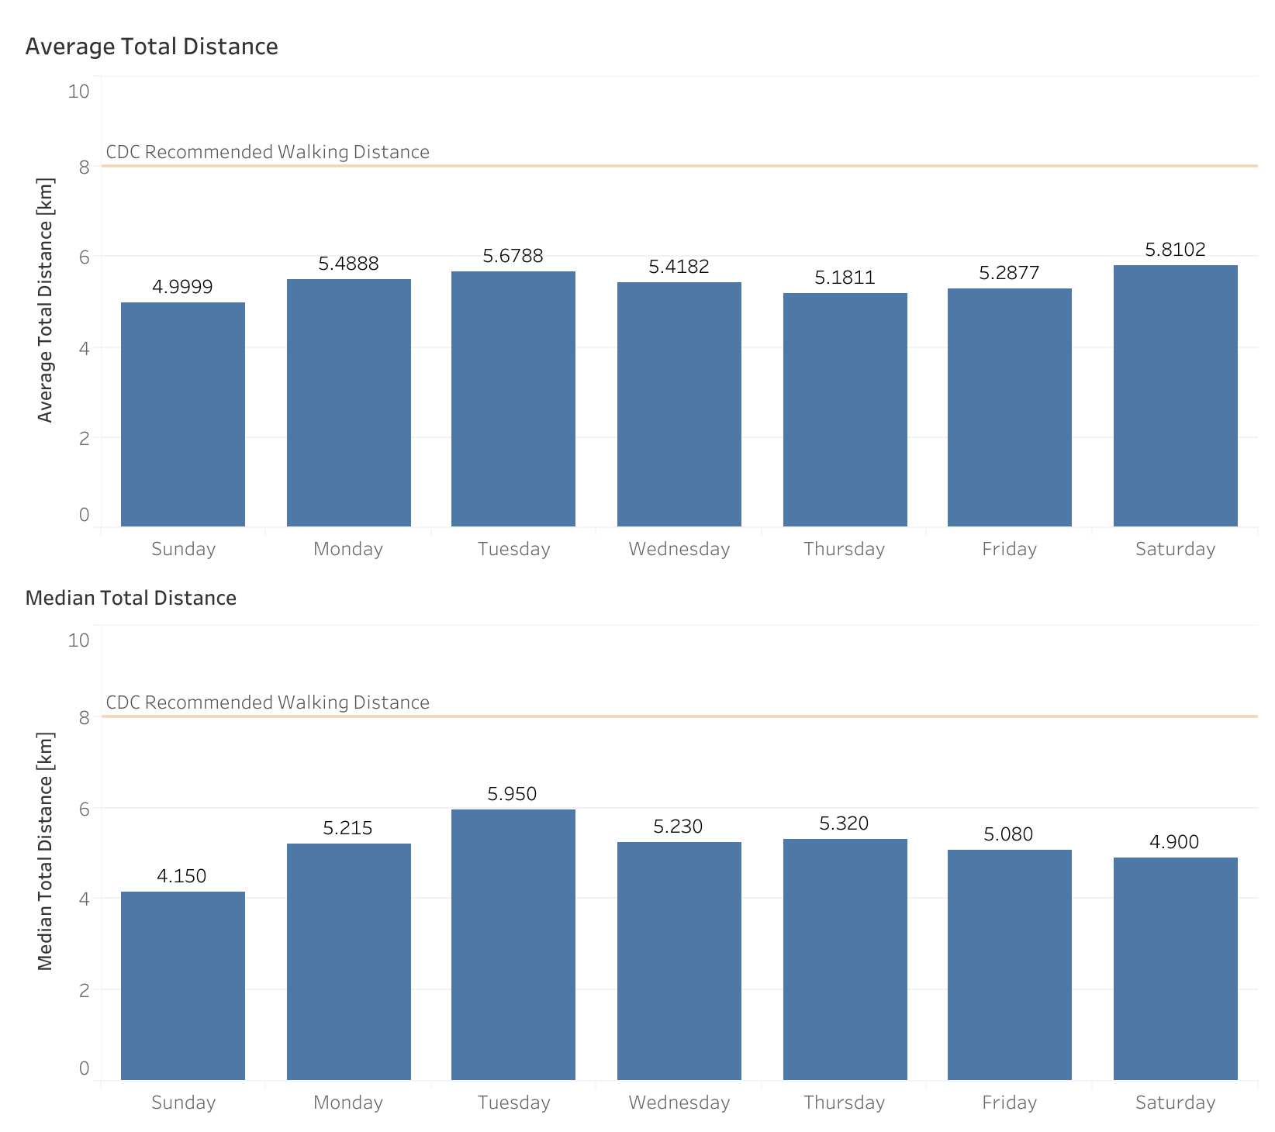
Users are also not traveling far distances on a daily basis.

Slide 21
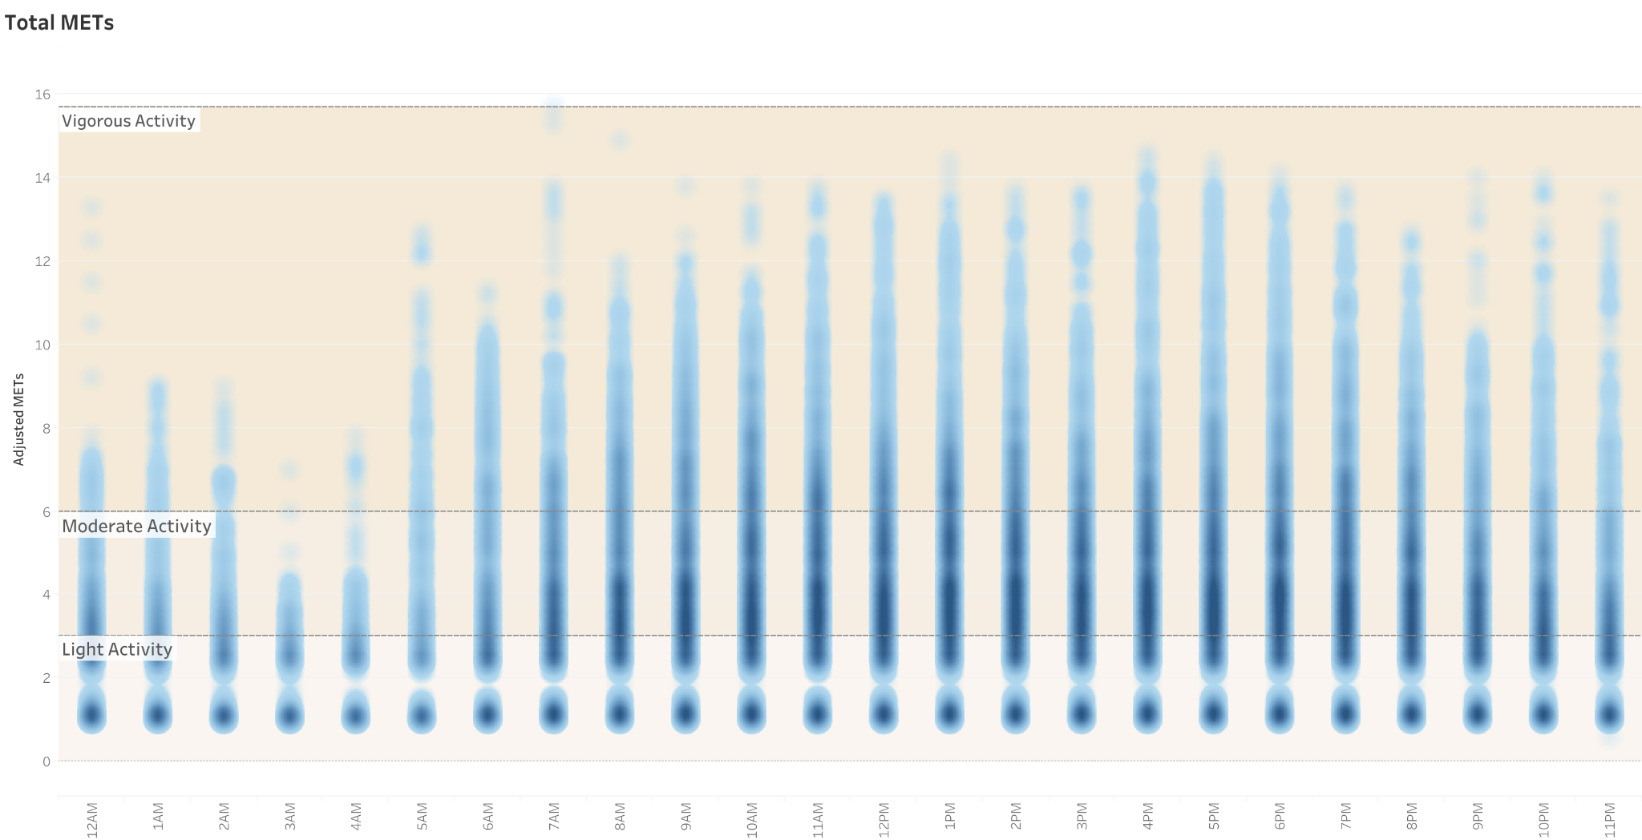
However, users are logging moderate to vigorous activities.

Slide 22
Insights
How are users exercising?
User activity is not directly tied to steps taken/distance traveled.
Likely exercise routines:
Weight training
Yoga
Non-step related cardiovascular activities such as swimming.

Slide 23
Goals for analysis:
Identify behavioral patterns of smart device users.
Apply behavioral patterns to Bellabeat.

Slide 24
User Profile
From non-Bellabeat users.
A typical smart device user..
Wears their device throughout the day, regardless of physical activity.
Has an opportunity to exercise after 5PM on most weekdays except Friday and Saturday.
Does not travel far by foot, suggesting usage of an exercise facility.

Slide 25
Application
To Bellabeat devices.
Smart-devices must fulfill:
Comfortable to wear throughout the day.
Unobtrusive to the user’s daily routine.
Reliably track & log wellness ailments without user intervention.

Slide 26
She’s busy
Recommendations.
Market around how Bellabeat’s portfolio of products provide convenience for the busy woman.
Focal points:
Leaf: Shower safe, long-lasting battery, flexible wearing options.
Time: Lightweight, long-lasting battery.
Spring: Dishwasher safe, long-lasting battery.
Bellabeat App: Easily view all of your data.

Slide 27
Further exploration
Do behaviors differ between men and women?
Do these behaviors hold up in a larger sample size?

Slide 28
Data Limitations
Sample size is extremely limited at 33 total users.
Sample limited to 1-month’s worth of data.
Some units are ambiguous such as distance.
Missing basic demographic data such as gender, sex, age.
Some users remove their smart-devices for extended periods of time.
Please refer to my discussion page on Kaggle for an explanation for the ‘value’ column.

Slide 29
About the Data
Data from FitBit users sourced from Kaggle.
Data manipulation in SQL. Please view the scripts used here.
Data visualizations made with Tableau Public.

